Slide 1
Preparing Students for the Diagnostic
Diagnostic
The most important thing you can do to get accurate data is to motivate students to put forth their best effort on the i-Ready Diagnostic, especially after a spring of remote learning. Before administering the first Diagnostic, use the following resources to energize students, review expectations, and set goals. In this document, you will find four presentations to prepare your students for the first Diagnostic. See below to locate your grade-level presentation.
Presentations Included:
Tips:
Internalize the presentation by reviewing it ahead of time.
Show this presentation the day of or a day before the Diagnostic.
Schedule time for the presentation.
Check in with students for understanding along the way.
End the presentation by asking students what strategies they want to use.
Optional slides: These slides are not required but encouraged:
– Incentive slide: Edit the presentation to include any class, school, or individual incentives.
– Embedded Universal Supports slides: When needed, preview these features with students (slides 82–85).
Grade K
Grades 1–2
Grades 3–5
Grades 6–8
Embedded Universal Supports (Grades K–8)

Slide 2
Get Pumped Up for Success!
Kindergarten

Slide 3
What We Will Cover
Things to Know
What to Expect
Introduction Videos
Tips
Let’s Remember

Slide 4
“Why are we taking the i-Ready Diagnostic?”

Slide 5
Why take the i-Ready Diagnostic?
Remember, the Diagnostic helps us:
Find out what you know
Understand what you are ready to learn
Make the best use of your learning time

Slide 6
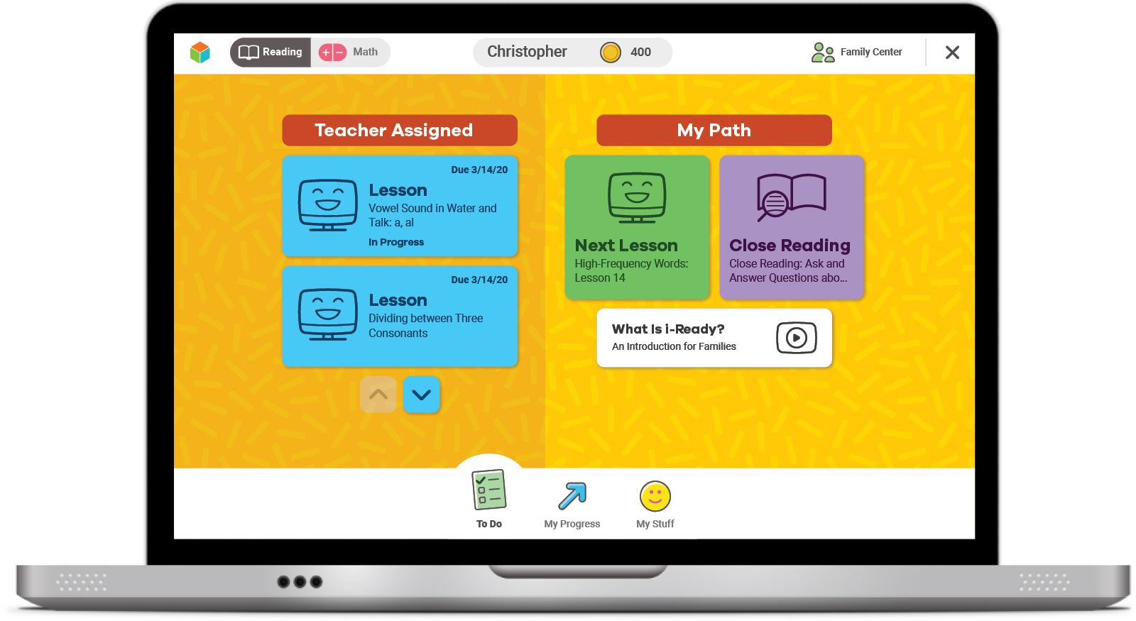
Online Lessons
After your Diagnostic, you'll get new Lessons.
If you try your best on the Diagnostic, online lessons will match what you need to learn.

Slide 7
How does the Diagnostic work?
i-Ready is adaptive. This means the questions change based on your answers to earlier questions. You will see questions you won’t know how to answer. That is okay!
Some questions will be . . .
Hard
Easy
Just Right!

Slide 8
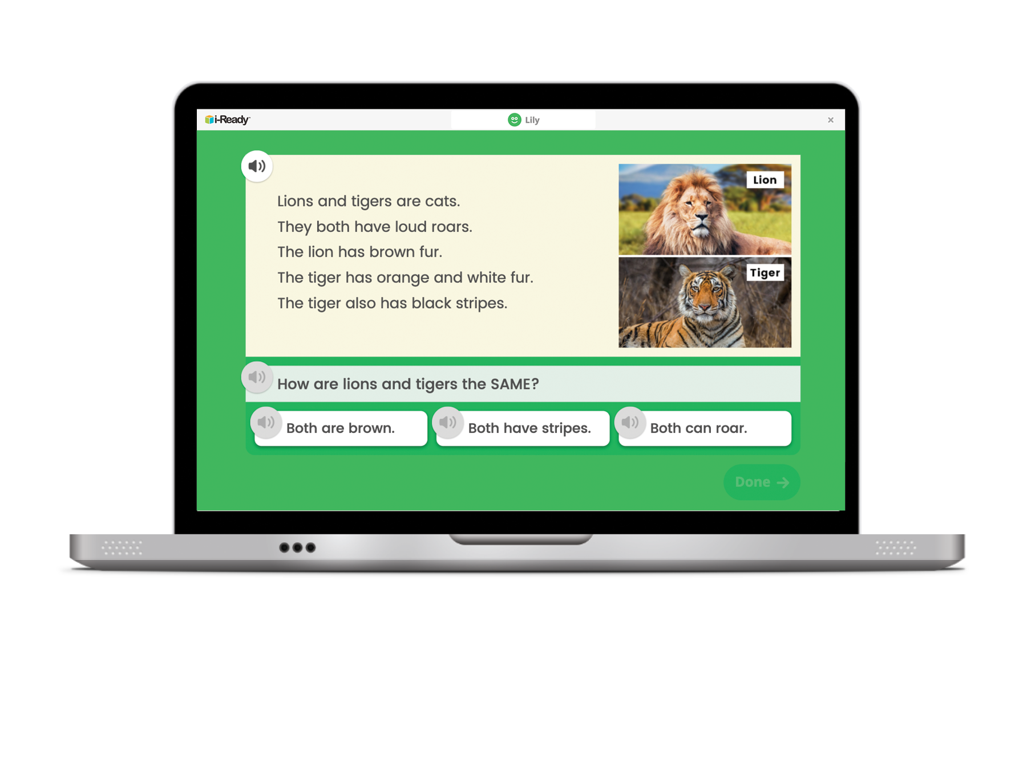
How does the Diagnostic work?
You might see a question that looks like this.

Slide 9
Why is the Diagnostic really important now?
This past spring, you were learning from home.
Doing your best on the Diagnostic now will help you and your teacher know what you learned while you were at home and what you are ready to learn.

Slide 10
What should you do?
Try your best. Do not rush, but do not spend too much time on any one question.

Slide 11
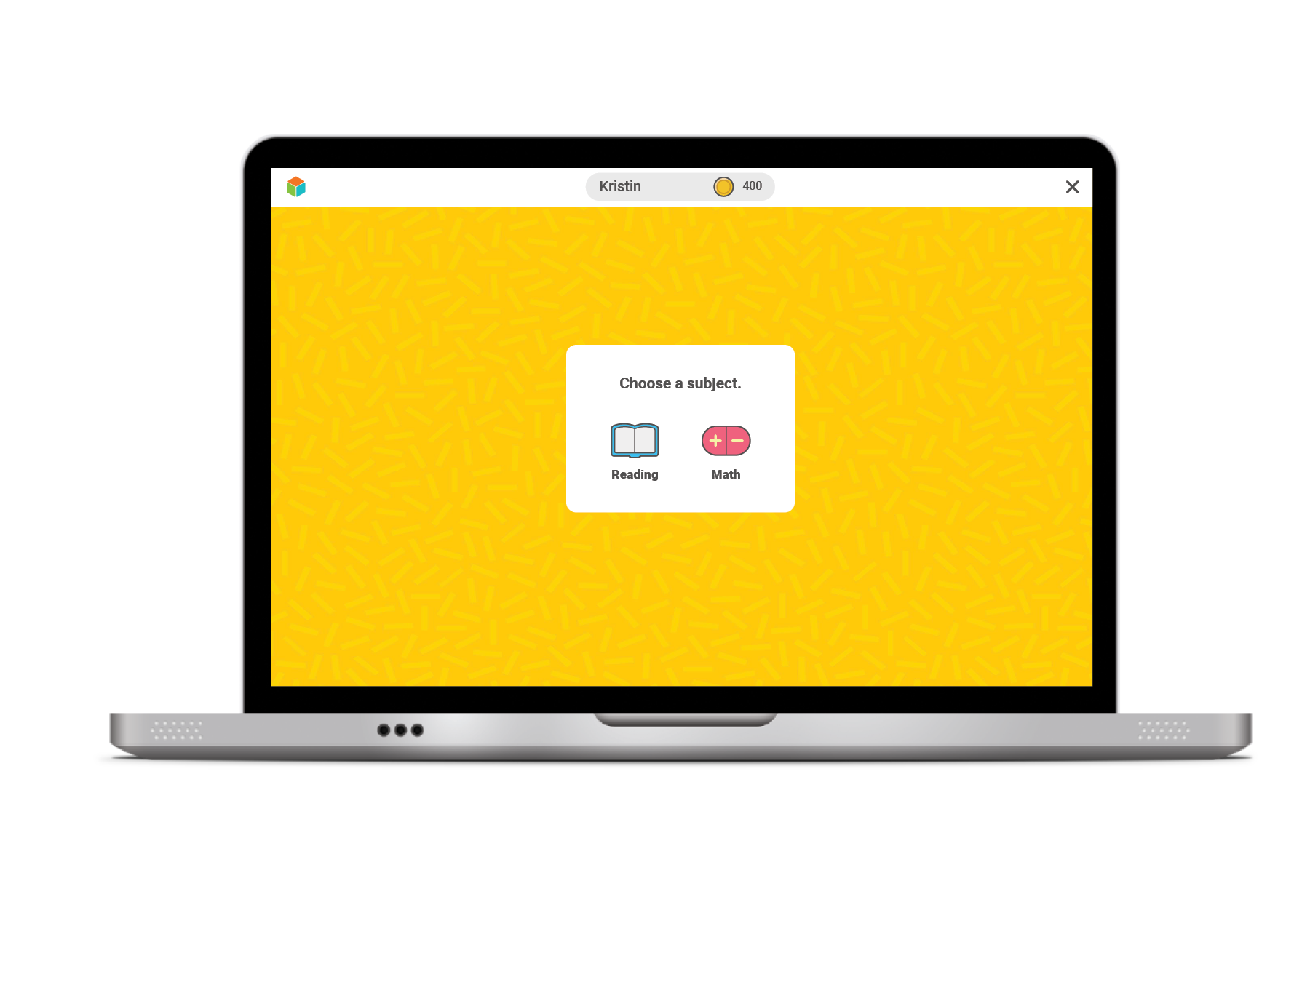
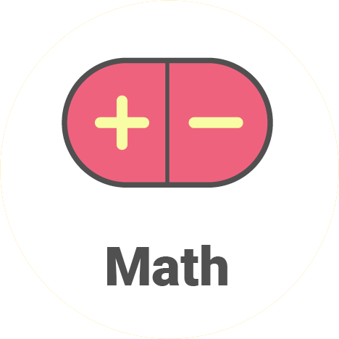
Once you log in, you will see this:
For Reading, click on the book.
For Math, click on the math signs.
I will tell you which one to click.

Slide 12
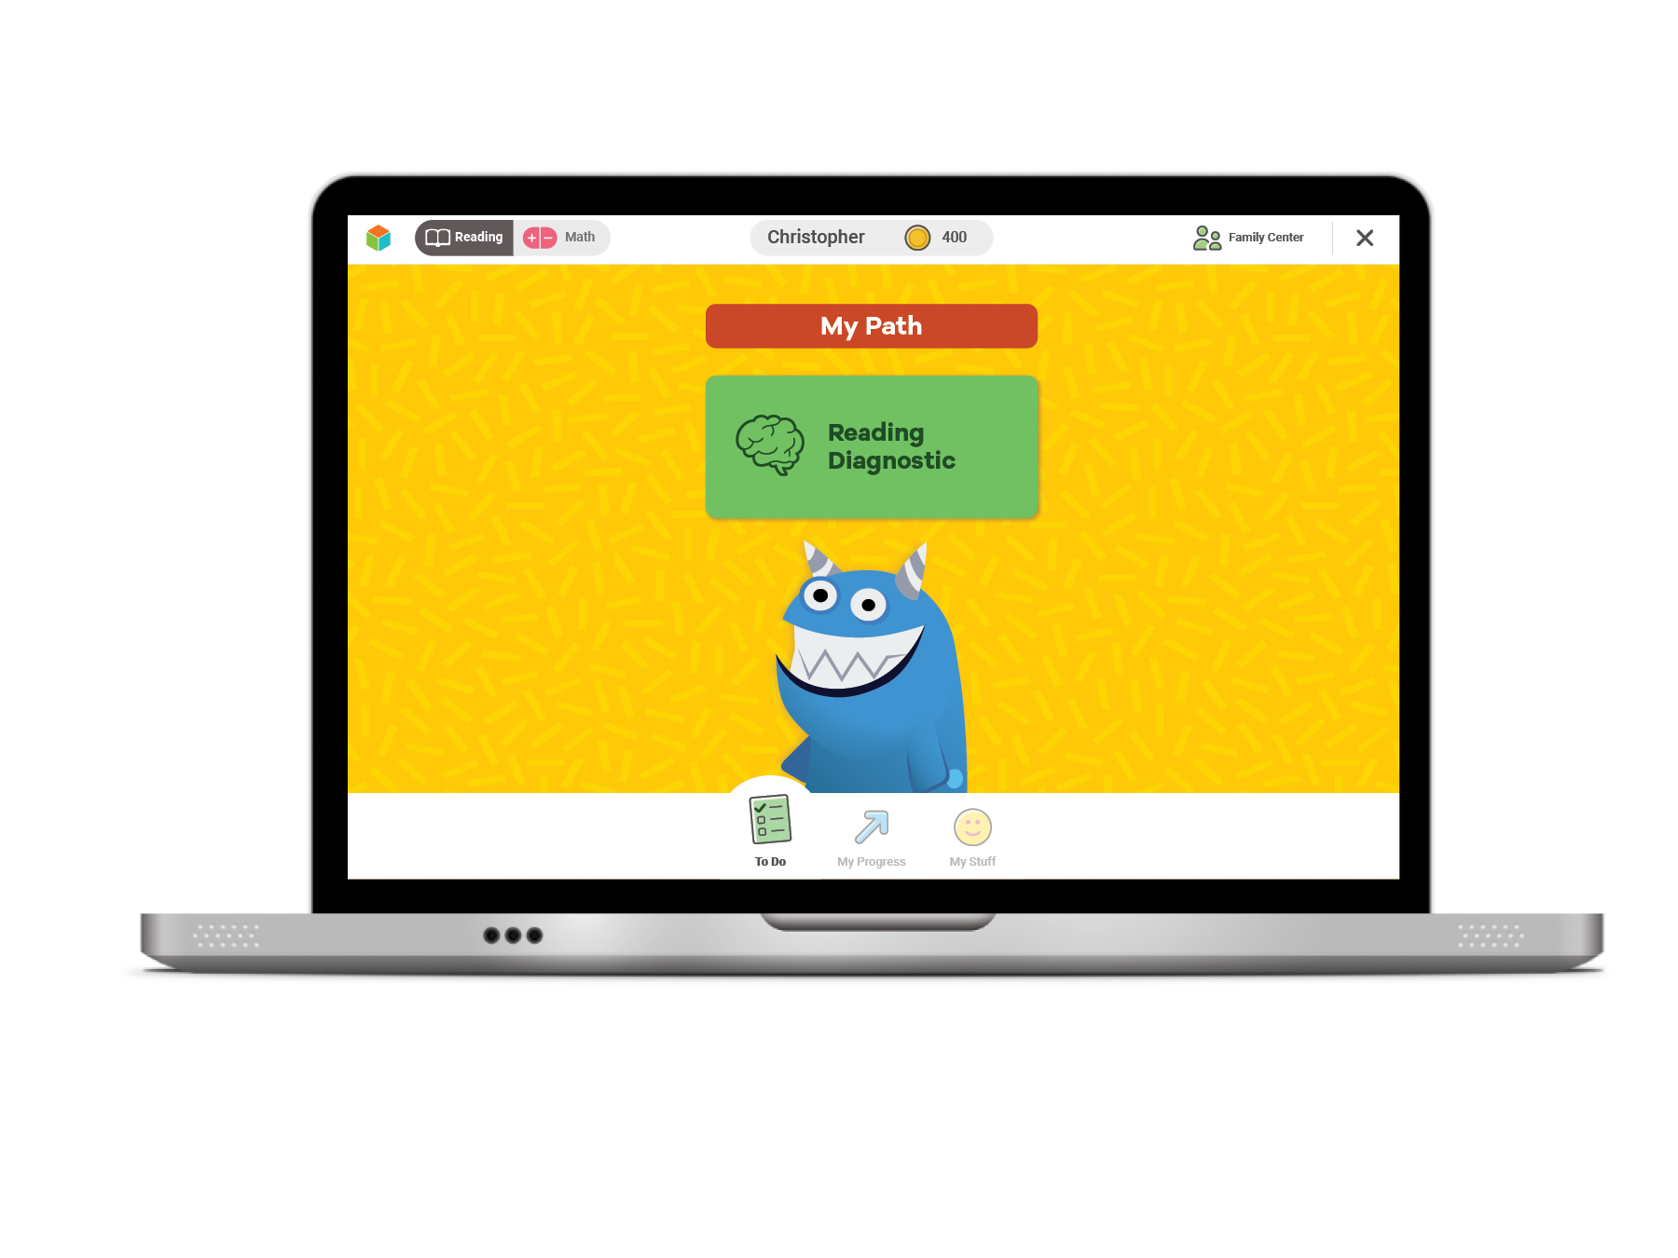
Next, you will see a page like this:
Click the green button to start your Diagnostic.

Slide 13
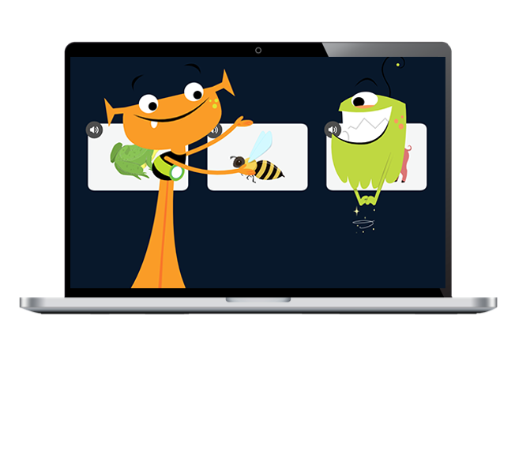
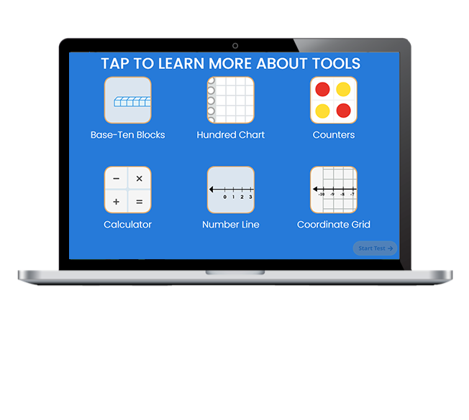
Next, you will:
Watch a video.
Click on each button to watch a video about a tool. Then select START TEST.

Slide 14
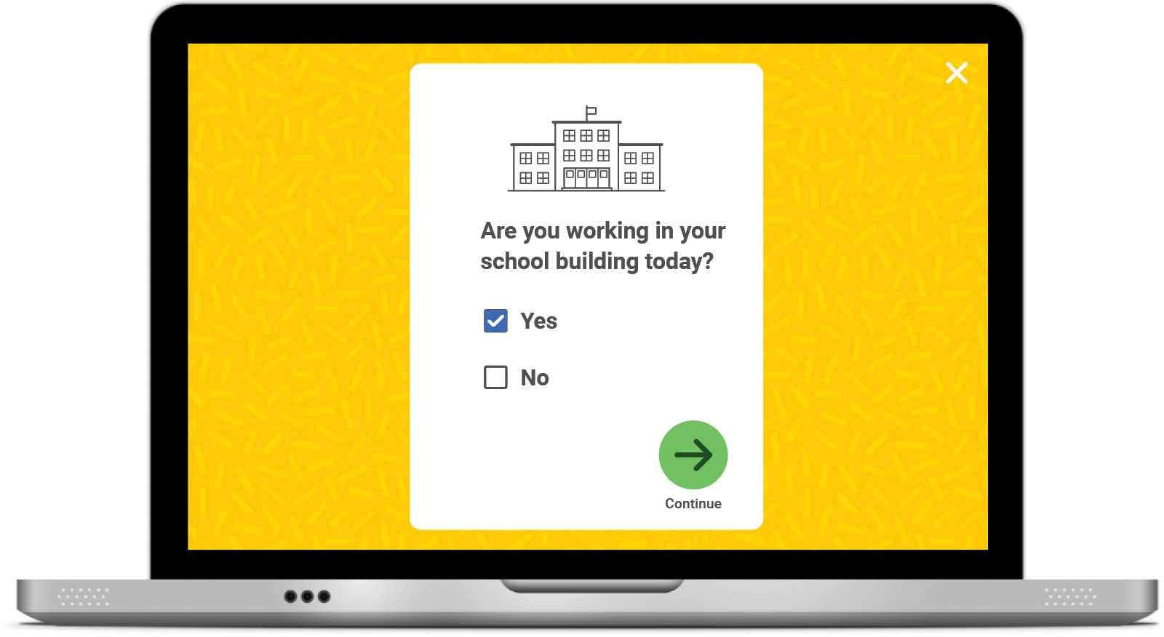
Student Survey
Once you START or RESUME your Diagnostic, you will see this question pop up on your screen:
Click No if you are taking the Diagnostic at HOME.
Click Yes if you are taking the Diagnostic at SCHOOL.
Click the green arrow to move on.

Slide 15
Optional
Introductory Demo Videos
You will get to try this on your own!
MATH
READING
Optional

Slide 16
Helpful Tips
Take your time and do not rush.
Read each question and answer choice carefully.
Try your best! Remember: Just like
when we are at school, your
teacher and family cannot help!

Slide 17
Helpful Tips
For Math—Show your work.
For Reading—Read each passage carefully.
Check your work.

Slide 18
Our Plan
After the Diagnostic, i-Ready creates a special report for you and your family.

Slide 19
Optional
Our Incentives
Class incentives
Individual incentives
Optional

Slide 20
Let’s Remember . . .
To do my best on
i-Ready,
I will . . .

Slide 21
You Will Rock It!

Slide 22
Get Pumped Up for Success!
Grades 1–2

Slide 23
What We Will Cover
Things to Know
What to Expect
Introduction Videos
Tips
Let’s Remember

Slide 24
“Why are we taking the i-Ready Diagnostic?”

Slide 25
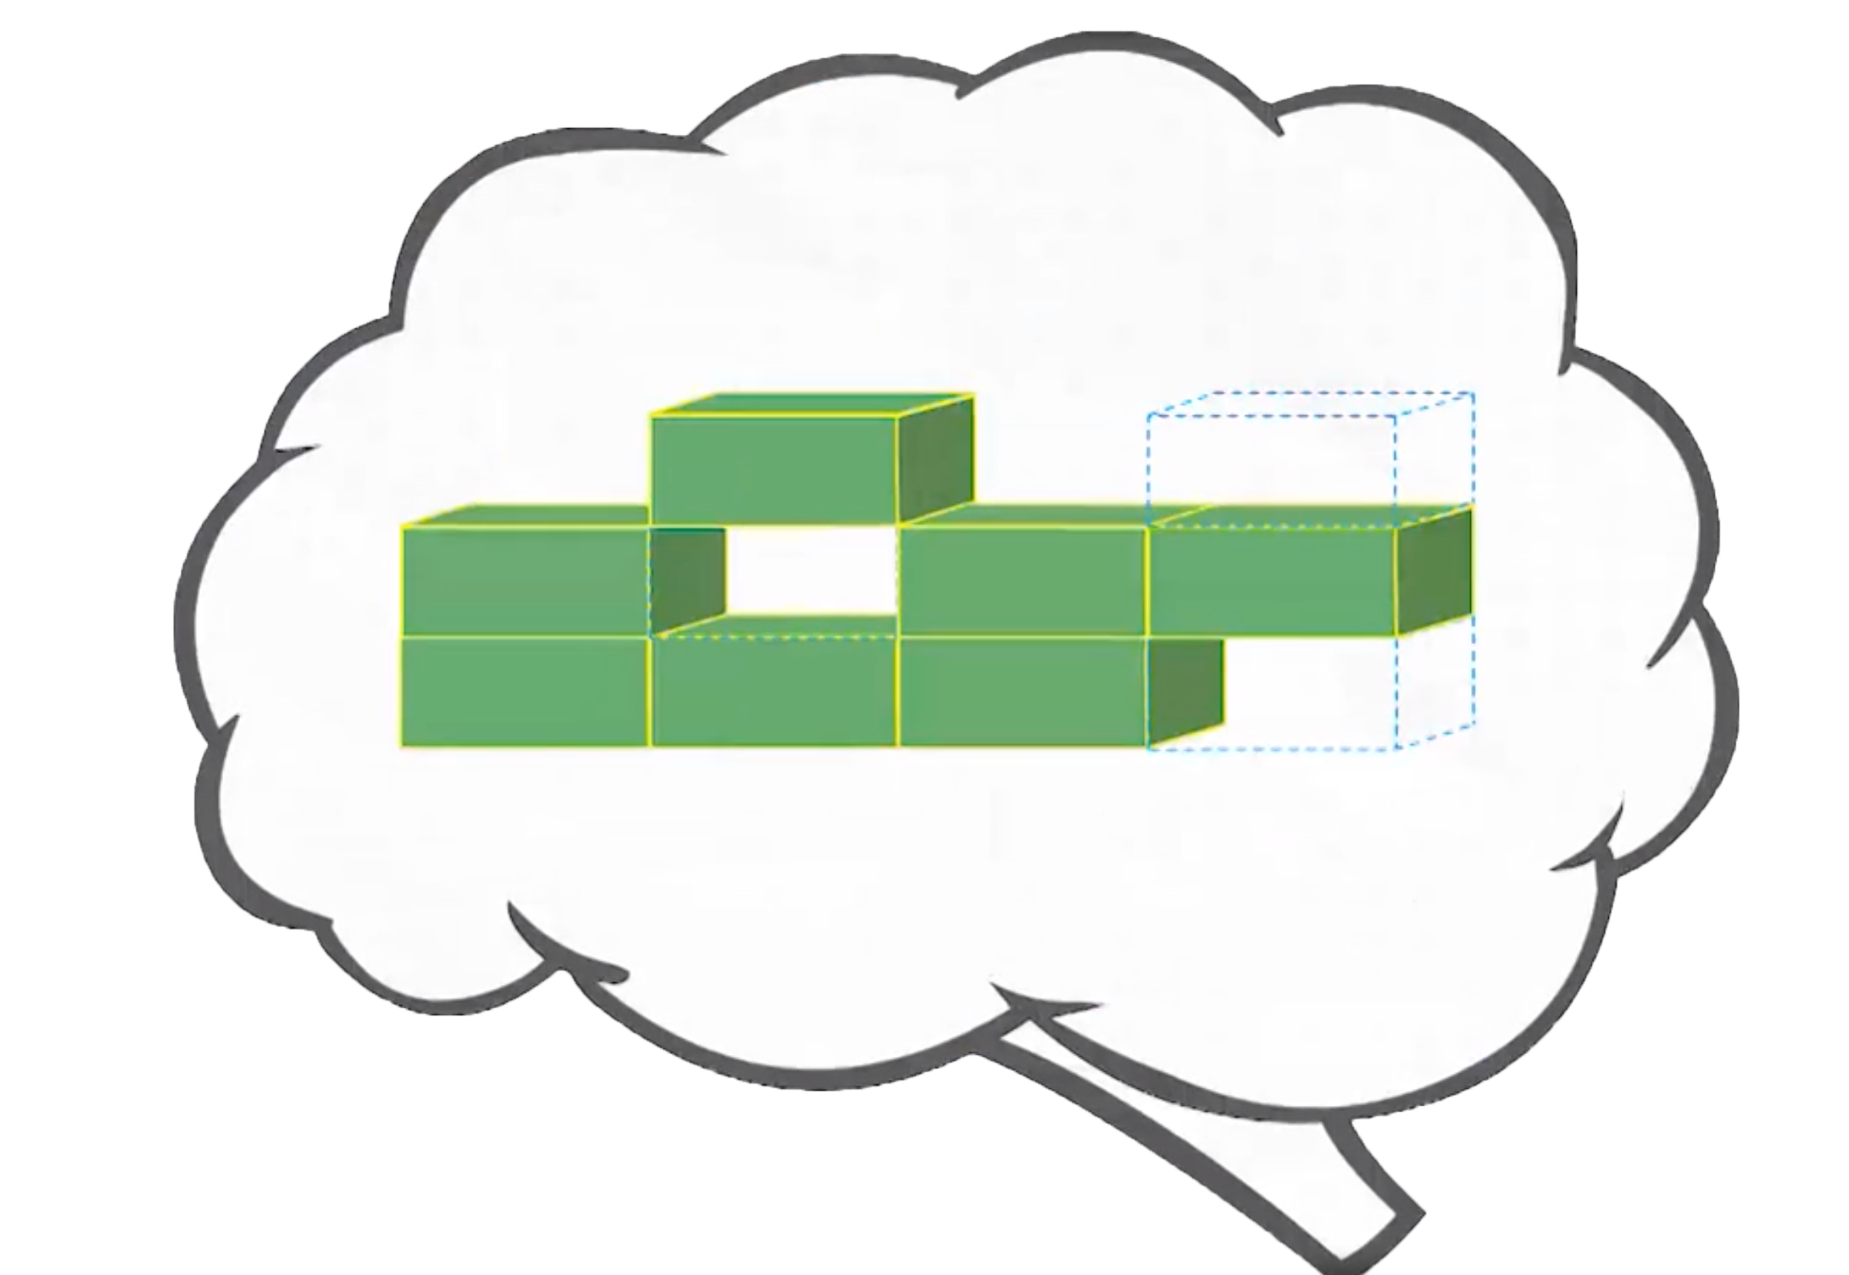
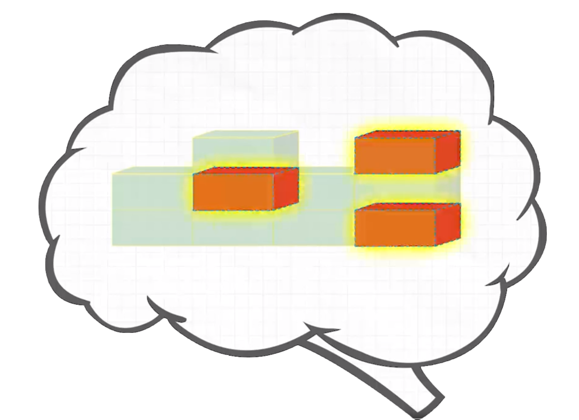
Remember, the Diagnostic Is Important Because It Helps You and Your Teachers . . .
Show what you know! Try your best so you can show what you’ve learned.
Make the best use of your learning time
Understand what you already know
and what you need to learn
Notes:
Today, when you complete your Diagnostic, you will see a score pop up on your screen. This score is one of many that you will see on your Diagnostic report. Your Diagnostic report will help us see the areas where you have strengths and the areas where we can help you grow. We will talk about your Diagnostic report and your personal learning goals when we meet for our data chat.

Slide 26
Online Lessons
If you try your best on the Diagnostic, lessons will match what you need to learn.
The results of your Diagnostic decide what lessons you will get.

Slide 27
How does the Diagnostic work?
i-Ready is an adaptive test. This means the questions change based on your answers.
Some questions will be . . .
Hard
Easy
Just Right!

Slide 28
Why is the Diagnostic really important now?
This past spring, you were learning from home.
Doing your best on the Diagnostic now will help you and your teacher know what you learned while you were at home and what you are ready to learn.

Slide 29
What should you do?
Remember this test is adaptive! You should try your best, but know that you’ll get questions you don’t know how to answer.
You will see questions you won’t know how to answer because you haven’t learned them yet. That is okay! Choose the best answer and move on.
Try your best. Do not rush, but do not spend too much time on any one question.
Too Hard
Too Easy
Just Right

Slide 30
Once you log in, you will see this:
Select the subject your teacher tells you.

Slide 31
Next, you will see a page like this:
Click the green button to start your Diagnostic.

Slide 32
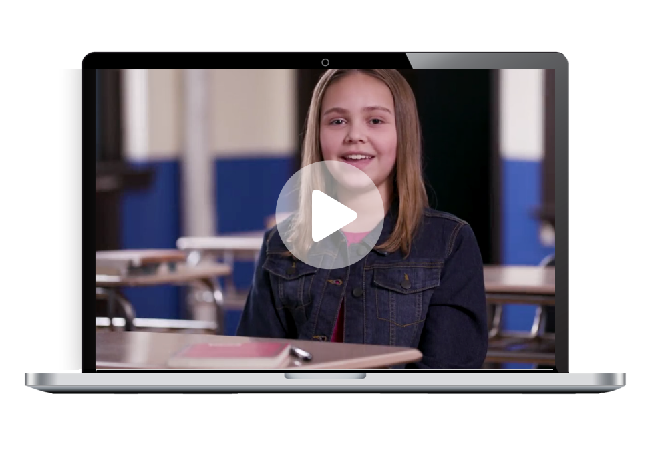
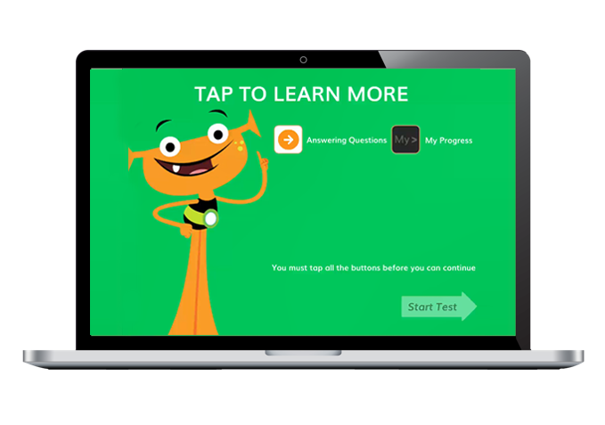
Next, you will:
Click on each button to watch a video about each tool.
Watch a video.
You must click on all of them before you can press start.

Slide 33
Student Survey
Once you START or RESUME your Diagnostic, you will see this question pop up on your screen:
Click No if you are taking the Diagnostic at HOME.
Click Yes if you are taking the Diagnostic at SCHOOL.
Click the green arrow to move on.

Slide 34
Optional
Introductory Demo Videos
You will get to try this on your own!
MATH
READING

Slide 35
Helpful Tips
Take your time and do not rush.
Read each question and answer choice carefully.
Try your best! Remember: Just like
when we are at school, your
teacher and family cannot help!

Slide 36
Helpful Tips
For Math—Show your work.
For Reading—Read each passage carefully.
Check your work.

Slide 37
Our Plan
After the Diagnostic, i-Ready creates a special report for you and your family.

Slide 38
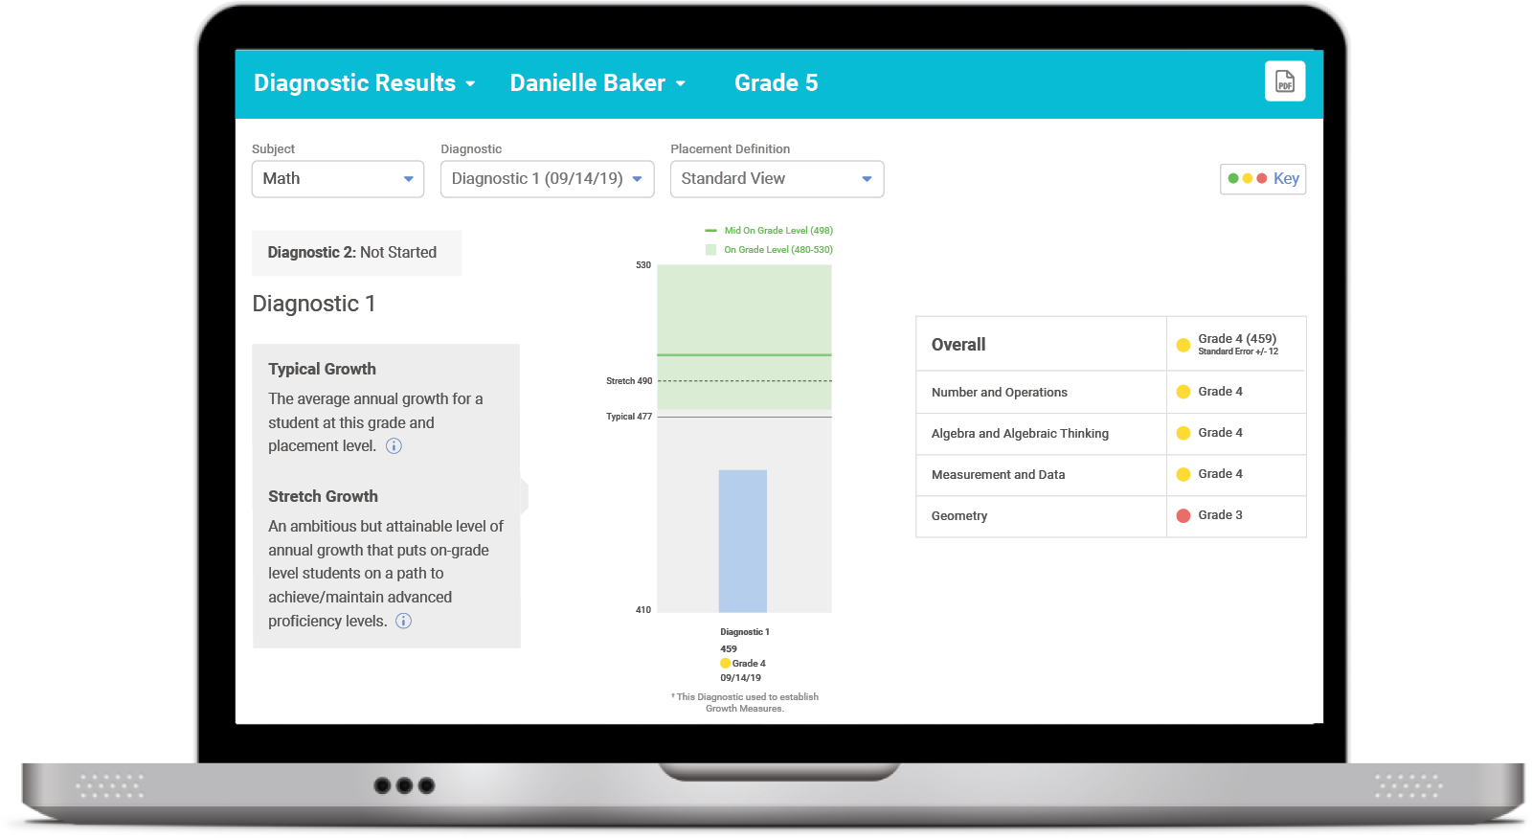
Our Plan
After the Diagnostic, we can review your results and goals.

Slide 39
Optional
Our Incentives
Class incentives
Individual incentives
Optional
Notes:
For ideas from other educators, visit i-ReadyCentral.com/Ideas.

Slide 40
Reflection
To do my best on i-Ready, I will . . .

Slide 41
You Will Rock It!

Slide 42
Get Pumped Up for Success!
Grades 3–5

Slide 43
What We Will Cover
Things to Know
Tips
What to Expect
Let’s Remember
Introduction Videos

Slide 44
“Why are we taking the i-Ready Diagnostic?”

Slide 45
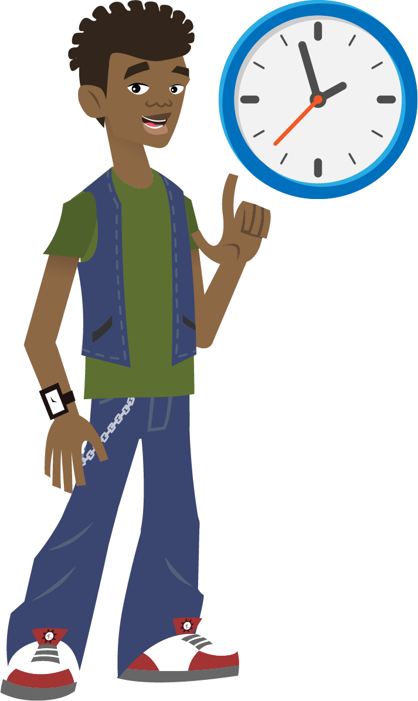
Remember, the Diagnostic Is Important Because It Helps You and Your Teachers . . .
Show what you know! Try your best so you can show what you’ve learned.
Make the best use of your learning time
Understand what you already know
and what you need to learn
Notes:
Today, when you complete your Diagnostic, you will see a score pop up on your screen. This score is one of many that you will see on your Diagnostic report. Your Diagnostic report will help us see the areas where you have strengths and the areas where we can help you grow. We will talk about your Diagnostic report and your personal learning goals when we meet for our data chat.

Slide 46
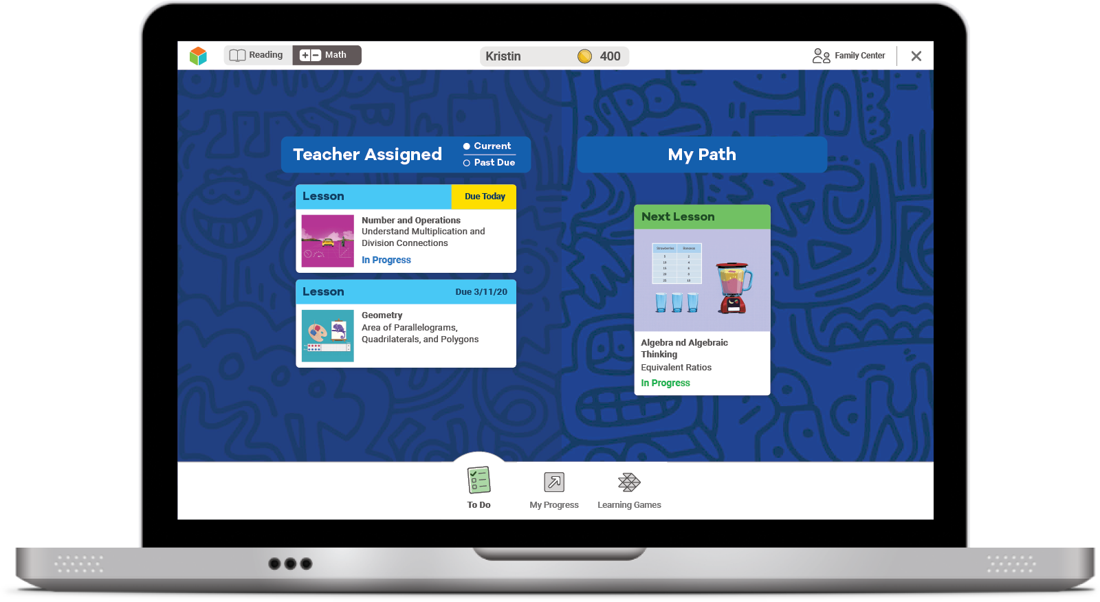
Online Lessons
If you try your best on the Diagnostic, lessons will match what you need to learn.
The results of your Diagnostic decide what lessons you will get.

Slide 47
How does the Diagnostic work?
i-Ready is an adaptive test. This means the questions change based on your answers.
Some questions will be . . .
Hard
Easy
Just Right!

Slide 48
Why is the Diagnostic really important now?
This past spring, you were learning from home.
Doing your best on the Diagnostic now will help you and your teacher know what you learned while you were at home and what you are ready to learn.

Slide 49
What should you do?
Remember this test is adaptive! You should try your best, but know that you’ll get questions you don’t know how to answer.
You will see questions you won’t know how to answer because you haven’t learned them yet. That is okay! Choose the best answer and move on.
Try your best. Do not rush, but do not spend too much time on any one question.
Too Hard
Too Easy
Just Right

Slide 50
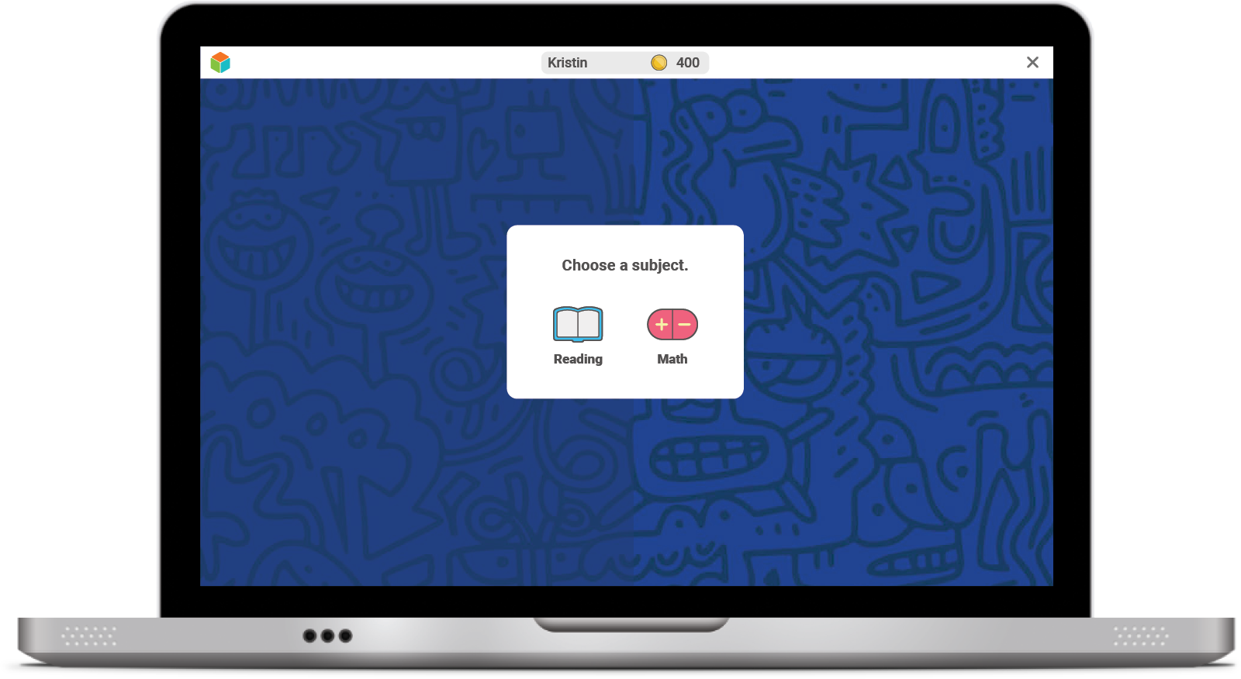
Once you log in, you will see this:

Slide 51
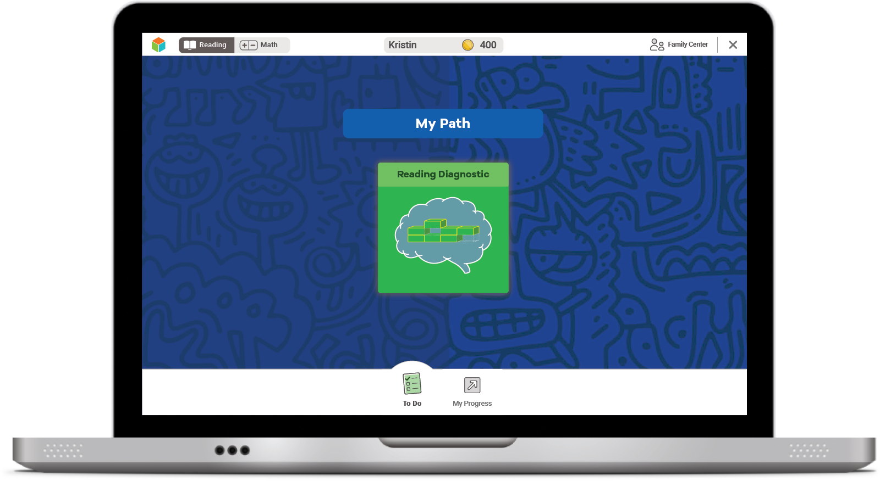
Next, you will see a page like this:
Select the green button to start your Diagnostic.

Slide 52
Next, you will:
Click on each button to watch a video about each tool.
Watch a video.
You must click on all of them before you can press start.

Slide 53
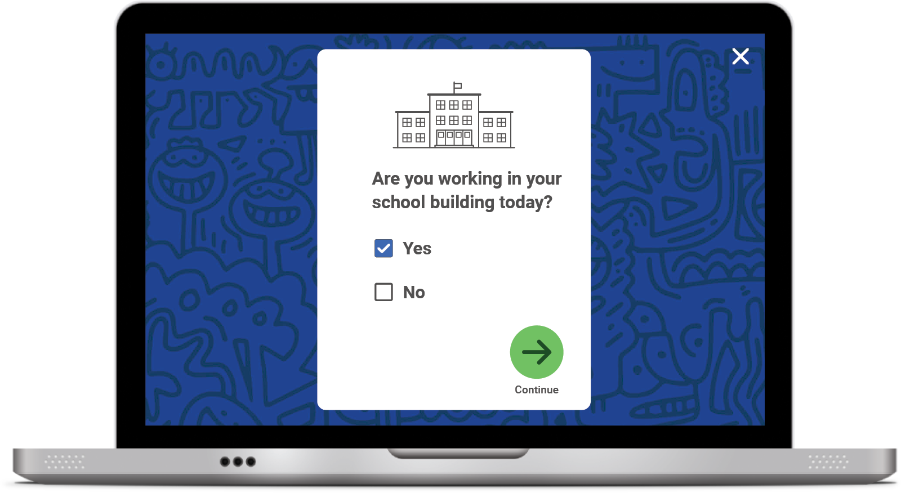
Student Survey
Once you START or RESUME your Diagnostic, you will see this question pop up on your screen:
Click No if you are taking the Diagnostic at HOME.
Click YES if you are taking the Diagnostic at SCHOOL.
Click the green arrow to move on.

Slide 54
Optional
Introductory Demo Videos
You will get to try this on your own!
MATH
READING

Slide 55
Helpful Tips
Take your time and do not rush.
Read each question and answer choice carefully.
If you get a question you have not learned yet, try your best. Like school, your teacher and family cannot help!
For Math—Show your work on paper for every problem.
For Reading—Read each passage carefully, and reread the passage when necessary.
Check your work before going to the next question.

Slide 56
Our Plan
After the Diagnostic, i-Ready creates a special report for you and your family.

Slide 57
Our Plan
We can talk about:
How you did
What your growth goals are
Your strengths and areas for growth
After the Diagnostic, we can review your results and goals.

Slide 58
Optional
Our Incentives
Class incentives
Individual incentives
Optional
Notes:
For ideas from other educators, visit i-ReadyCentral.com/Ideas.

Slide 59
Reflections
What strategies do you plan to use on your i-Ready Diagnostic?
What do you want to remember?

Slide 60
Get Ready to Take the Diagnostic
Grades 6–8

Slide 61
What We Will Cover
Things to Know
Tips
What to Expect
Let’s Remember
Introduction Videos

Slide 62
“Why are we taking the i-Ready Diagnostic?”

Slide 63
Remember, the Diagnostic Is Important Because It Helps You and Your Teachers. . .
Make the best use of your learning time
Show what you know! Try your best so you can show what you’ve learned.
Understand what you already know
and what you need to learn
Notes:
Today, when you complete your Diagnostic, you will see a score pop up on your screen. This score is one of many that you will see on your Diagnostic report. Your Diagnostic report will help us see the areas where you have strengths and the areas where we can help you grow. We will talk about your Diagnostic report and your personal learning goals when we meet for our Data Chat.

Slide 64
Online Lessons
If you try your best on the Diagnostic, lessons will match what you need to learn.
The results of your Diagnostic decide what lessons you will get.

Slide 65
How does the Diagnostic work?
i-Ready is an adaptive test. This means the questions change based on your answers.
Some questions will be . . .
HARD
EASY
JUST RIGHT

Slide 66
Why is the Diagnostic really important now?
This past spring, you were learning from home.
Doing your best on the Diagnostic now will help you and your teacher know what you learned while you were at home and what you are ready to learn.

Slide 67
What should you do?
You will see questions you won’t know how to answer because you haven’t learned them yet. That is okay! Choose the best answer and move on.
Try your best. Do not rush, but do not spend too much time on any one question.
Remember this test is adaptive! You should try your best, but know that you'll get questions you don't know how to answer.
Too Hard
Too Easy
Just Right

Slide 68
Once you log in, you will see this:

Slide 69
Next, you will see a page like this:
Select the green button to start your Diagnostic.

Slide 70
Next, you will:
Click on each button to watch a video about each tool.
Watch a video.
You must click on all of them before you can press start.

Slide 71
Student Survey
Once you START or RESUME your Diagnostic, you will see this question pop up on your screen:
Click No if you are taking the Diagnostic at HOME.
Click Yes if you are taking the Diagnostic at SCHOOL.
Click the green arrow to move on.

Slide 72
Optional
Introductory Demo Videos
MATH
READING

Slide 73
Helpful Tips
Take your time and do not rush.
Read each question and answer choice carefully.
If you get a question you have not learned yet, try your best. Like school, your teacher and family cannot help!
For Math—Show your work on paper for every problem.
For Reading—Read each passage carefully, and reread the passage when necessary.
Check your work before going to the next question.

Slide 74
Our Plan
After the Diagnostic, i-Ready creates a special report for you and your family.

Slide 75
Our Plan
We can talk about:
Progress toward your growth goals
Your strengths and areas for growth
How you did
After the Diagnostic, we can review your results and goals.

Slide 76
Optional
Our Incentives
Class incentives
Individual incentives
Notes:
For ideas from other educators, visit i-ReadyCentral.com/Ideas.

Slide 77
Reflections
Why is it important to try your best on the Diagnostic?
What strategies do you plan to use on your i-Ready Diagnostic?
What do you want to remember?

Slide 78
Embedded Universal Supports
Grades K–8

Slide 79
Keyboard Navigation
How: Using specific keyboard selections:
Tab, Shift + Tab, and Enter or Space
A box will appear showing where you are on the screen.
The Tab key will initiate keyboard navigation features.

Slide 80
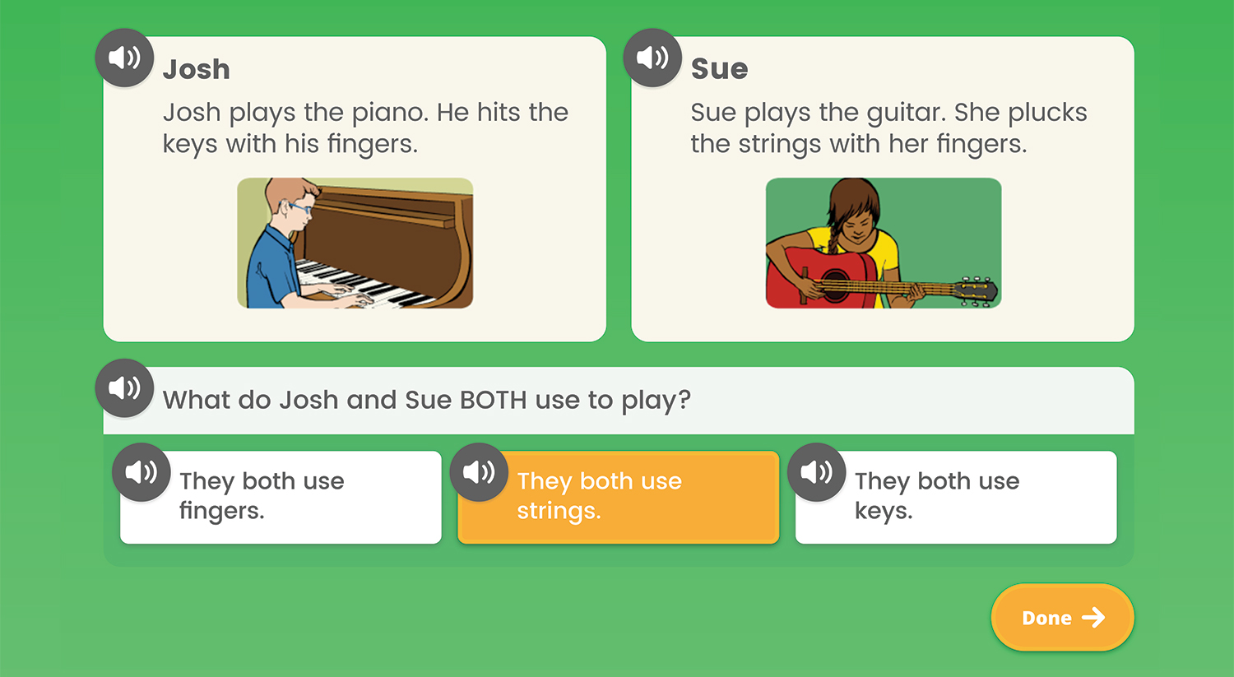
Audio Support
How: Using the speaker icon, wherever it appears
Notes:
Audio support is currently available for Diagnostic items at these levels:
Mathematics: Grades K–5
Phonics: Grades K–3
High-Frequency Words: Grades K–3
Vocabulary: Grades K–2
Phonological Awareness: Grades K–1
Reading Comprehension: Grade K
What: Provides the ability to click on an audio button (speaker icon) to have the corresponding text for a question and/or answer read aloud
Where: For select items in the Diagnostic, based on the domain and/or level of the items

Slide 81
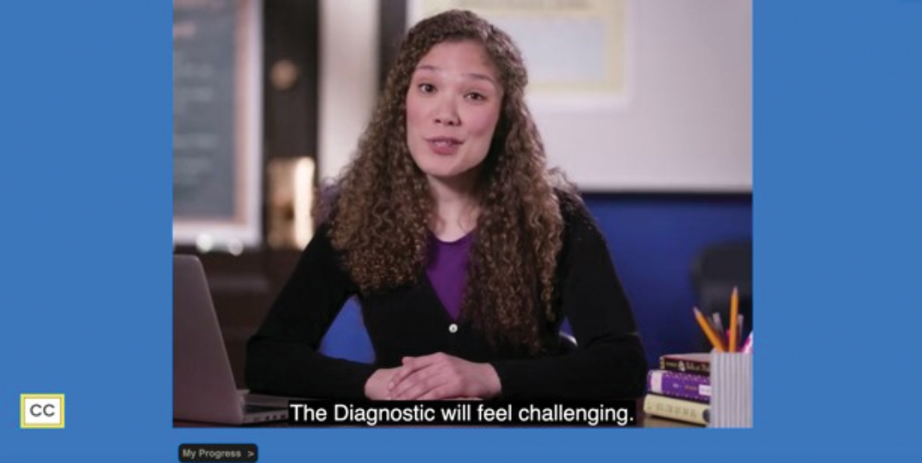
Closed Captioning
How: Using the CC box in the bottom left corner of the screen
Clicking the CC box allows you to view the text on screen.
Notes:
What: Provides the ability to display text on the computer screen that aligns to the audio
Where: In Diagnostic Introductory Videos for Grades 3+ when viewed through the student-facing Diagnostic assessment screen. Closed captioning is not available for test items at this time.

